Slide 1

PCEP for SRv6
draft-negi-pce-segment-routing-ipv6-03
draft-dhody-pce-pcep-srv6-yang-00
Mahendra Singh Negi | Dhruv Dhody | Siva Sivabalan | Prejeeth Kaladharan
Huawei |  | Cisco | RtBrick

Slide 2
Introduction & Motivation
Segment Routing (SR) can be used to steer packets through an IPv6 or MPLS network using the source routing paradigm.
Since SR can be applied to both MPLS and IPv6 data plane
A PCE be able to compute SR-Path for both MPLS and IPv6 forwarding plane
Segment identified by an IPv6 address
SID list as a list of IPv6 address (encoded in the SRH)
PCEP Extension to support SRv6
Extended SR-ERO, SR-RRO sub-objects for SRv6
Capability advertisement for SRv6 in PCEP
A new path setup type for SRv6

Slide 3
SRH & SRv6 SID
IP Header
IPV6 SRH HEADER
Payload
128 Bit
128 Bit
128 Bit
128 Bit
The “Function” can identify the L2VPN/L3VPN, and other services or APP.
Locator
Function(ARG)
Version | Traffic Class | Flow Label
Pload Length |  |  | Next=43 | Hop Linmit
Source Address
Destination Address
Next Header | Hdr Ext Len | Routing Type |  | Segments Left
Last Entry | Flags | Tag
Segment List[0]
Segment List[1]
Segment List[2]
Paylod

Slide 4
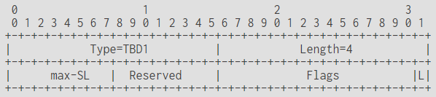
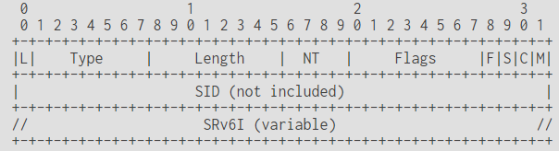
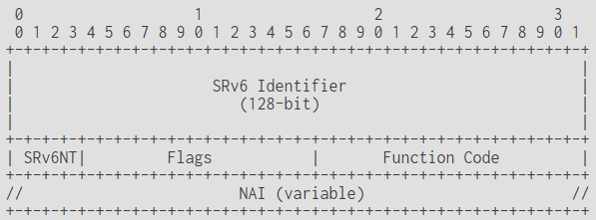
Update
SRv6-PCE-CAPABILITY sub-TLV
Update the SRv6 Capability handling
As per the PST and PCEP-SR
SRv6-PCE-CAPABILITY sub-TLV is defined
Alignment with PCEP-SR
Use of NAI-Type (NT) instead of SID-Type (ST)
Error Handling
SR-ERO interpretation
SRv6NT = Node ~ LOC
SR-ERO Sub-object
SRv6I

Slide 5
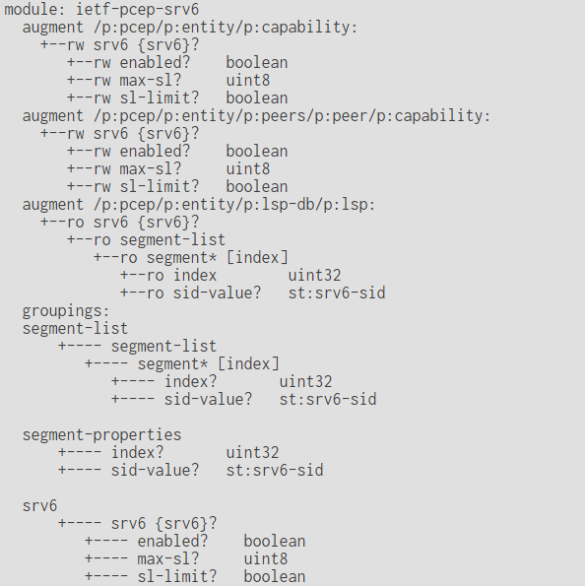
SRv6 Yang
Capability for SRv6
Max-SL
A feature for SRv6
A new PST for SRv6
A SRv6 Path
List of SRv6 SID (IPv6 address)

Slide 6
Questions & Next Steps
Support for SRv6 in PCEP is a reasonable requirement!
Is this the right approach?
Is this a good base for the WG to consider adoption?
draft-negi-pce-segment-routing-ipv6-03
Refine the document!

Slide 7
Thank You!

